Slide 1

GLOPAS Business Track Meeting
Cross-Border QR Acceptance
9th May 2019

Slide 2
BUSINESS TRACK – KEY IMPORTANCE
Purpose
Governance
Key Marketing Awareness and Drivers
Developing a seamless Customer Journey
Developing a business model
Cross Border Bilateral Partnership Agreement – includes an acquiring agreement and roles/responsibilities
Regulatory Clearance (From SG)
Approved Bank Clearance (From SG)
IT Applications
Developing a set of Terms and Conditions
Operations & Customer Service
Financial Processes
Financial (End to End Settlement Process)
Transaction flow
Refunds
Disputes
Forex Risk Management
MIS Reports
Banking Accounts
FX Pull Frequency and Time
Framework for Dispute Management
Claims/Refunds
Settlement disputes
Fraudulent Management
OpRex – A scale down version

Slide 3





MEETING AGENDA
Finance
Customer Service Matters
Transaction flow
Customer’s identification of GLOPAS acceptance points
CS point of contact
Service level agreement
Operations Matters
Business
Dispute Management
Fraud monitoring
Business Model
Legal & Compliance
Commercial Agreement

Slide 4
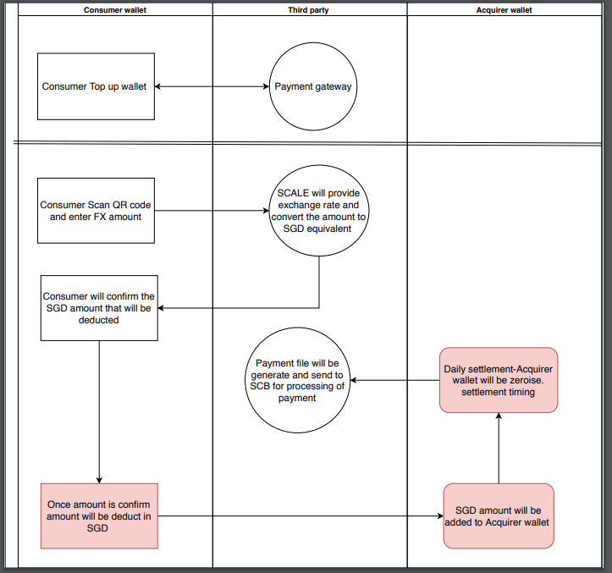
Finance- Outbound Transaction Flow
1
2
6
3
5
4

Slide 5
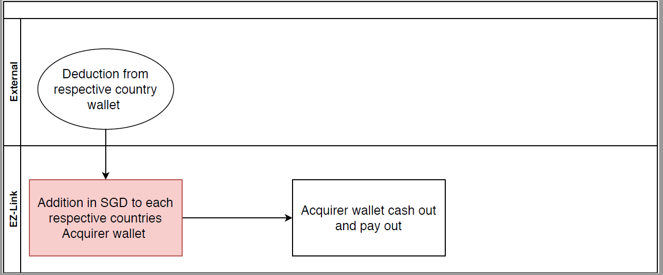
Finance- Inbound Transaction Flow
1
2

Slide 6
What's our progress – Finance
Met up with bank and in discussion of the bank account set up with SCB
SCALE (FX layer) will be open concurrently with the bank account
Internally the funds movement flow and has been finalised and also settlement flow

Slide 7
Follow up actions - Finance
Wallet cut off timing, how are we going to reconcile with each counter-parties.
Exceptional handling (if needed) Eg: refunds, technical error or etc
Settlement for pilot trail and going forward. Eg: will it be monthly, weekly or etc
Bank arrangement, what is the progress for each countries
Reports

Slide 8
Operations matters
Dispute Management
Fraud Monitoring
Facilitate refund based on the following conditions:
Payment system related
Must be within agreed timeline (5 days from transaction date)
Investigations must be supported by reports & refund to be approved by both Issuer and acquirer
Do not refund if customer made payment without confirming receipts
Process of refund will be handled by respective Issuer.
Operations controls
Merchant assessment during onboarding process
(e.g. non acceptance of merchant in gambling/illegal businesses)
Security controls
Prevention of replicas/fake Glopas QR codes, sharing of security incidents
Information security/ IT Infra security
Velocity monitors
To discuss if any requirement for fraud monitoring
Operation Matters
Dispute Management-Merchant
Dispute Management-Customer
Deal directly with customer based on the followings:
Cancellation by customer
Cancellation by merchant
Double deductions (if discovered on the spot)
Error in transaction amount
Recommended not to perform partial refund
Void erroneous transaction and perform a new transaction
No late settlement posting from merchant to acquirer
Any disputes on settlement, contact local acquirer.
Lemon Law according to respective country’s practices.
Strongly advised to approach merchant for refund if customer is still in the country
Contact Wallet Issuer if customer has returned to home country
Exception handling
Arbitration process
Which country’s law to take precedence?
.

Slide 9



Dispute Refund Flow
Billing
Issuer (EZ-Link)
Acquirer (Octopus)
Payment
Report Dispute
Refund
Charge
Investigation
Payment for goods/service
If a dispute occurs
Customer (SG)
Merchant (HK)

Slide 10
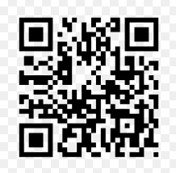


Customer Service Matters
Identification
Merchant list of individual countries to be shared
Physical signage
Use of common Glopas logo/marks
Acquirer and merchant identification in reports with Country coding
Service Level Agreement
Point of Contact
Response timeline
Investigation form and checklist of items/reports to be attached
Use of systems/tools for investigations
Customers/Merchants
Contact respective wallet issuer
Acquirer/Issuers
First level
Escalation
Business/Fraud contact

Slide 11
Commercial Agreement – key points
Commercial Agreement that covers the followings:
Two party contracts across respective territories – eg. EZL & Octopus, Rabbit & T-money
Local Issuer to appoint Foreign Party as Acquirer (“Acquirer”) for cross-border QR payment –
(i) Local party issuer;
(ii) overseas party acquirer
Acquirer’s Undertakings –
(i) acquirer responsible for any master merchant or sub-acquirer,
(ii) handling customer disputes,
(iii) merchant issues,
(iv) handling onground QR technical issues
Issuer and Acquirer to agree on API
Respective local regulator’s requirements for cross-order payment transactions
- issuers and acquirers to check with respective Central Bank on approvals/licences for cross
border payments
Necessary regulatory licenses to perform as issuer or acquirer respective
- issuers and acquirers to confirm that it has necessary licence/approval as issuer or acquirer
(eg EZL will need to apply for acquirer licence under new Payment Services Act by Q4 2019)
Validity of contract – suggest 5 years (whether from date of signing or launch)

Slide 12
Commercial Agreement – key points
Commercial Agreement that covers the followings (cont’d):
Termination clause – eg 6 months’ notice
Termination if pursuant to regulator direction or loss of licence
Marketing obligations – (i) A&P (ii) right to user issuer logos
Provisions relating to Forex system layer – each party to subscribe to Forex service
Customer service handling and transaction disputes
- handling of reversal of failed or refund transactions
- issuer and acquirer to agree on other party’s handling refunds (void via system or cash refund),
consider risk of abuse of QR payment as overseas cash withdrawal
Suspicious transaction monitoring - eg. Moneylaundering, spike in transactions at customer/merchant level
Security Arrangement & features
Data Privacy Provisions – handling of customer personal data in line with country’s privacy laws
Jurisdiction and dispute resolution – (i) which territory (ii) court, mediation or arbitration
Technical APIs and Operations Manual/Settlement Procedures as Appendix to main Agreement

Slide 13
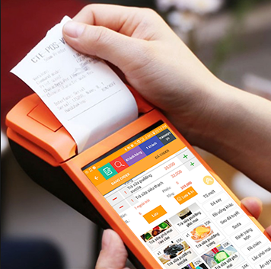
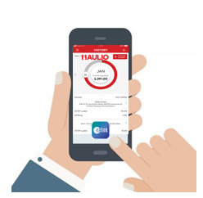
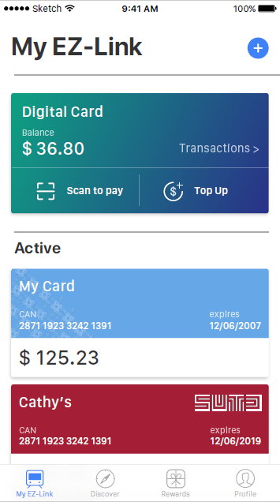
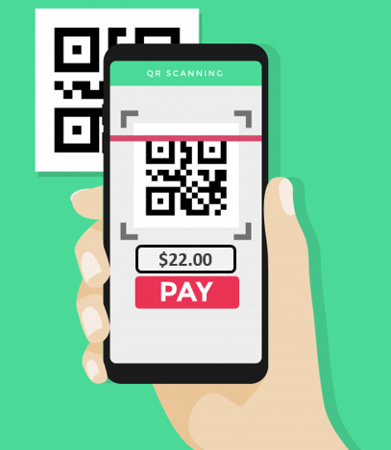
Business Matters
Commercial terms:
Zero issuer fee charged by Issuer to Acquirer for acceptance of payment
Issuer to keep any FX mark up
3
Payment received
Receipt printed
Merchant release goods/services
Issuer (EZL) takes FX mark up
1
2
Acquirer (Octopus) takes transaction fees from Merchant
EZL Customer holidaying in Hong Kong purchases a bottle of water
Customer launches EZL Mobile App
Scans O! ePay’s QR
Input amount in HKD to be paid

Slide 14
2017 Inbound Arrivals to Singapore
South Korea
46% First time visitor
34% Frequent visitor
Thailand
32% First time visitor
59% Frequent visitor
China
56% First time visitor
32 % Frequent visitor
Total inbound arrivals from GLOPAS member countries: 5,252,164 visitors
*Information taken from Singapore Tourism Board (Last updated 5 March 2019)
https://www.stb.gov.sg/content/stb/en/statistics-and-market-insights/tourism-statistics/annual-report-on-tourism-statistics.html

Slide 15
Outbound Departures of Singaporeans
Most visited GLOPAS member country:
Thailand
China
Hong Kong
Taiwan
South Korea
Total 2017 outbound departures to Glopas Member Countries: 2,935,020
*Information taken from Department Statistic Singapore, last updated 02 January 2019.
https://www.singstat.gov.sg/find-data/search-by-theme/industry/tourism/latest-data
*Figures are not indicative of unique travelers

Slide 16
Thank you

